Slide 1
DEVELOPMENTAL PSYCHOLOGY
THEME 3

Slide 2
Developmental Psychology Is a branch of psychology that studies physical, cognitive, emotive and social change throughout the life span. It studies the development of cognition, language, sensori-motor skills, personality, and morality in children to adulthood.

Slide 3
Study all stages of life, but usually focus on infant/child development:
Prenatal – Conception to Birth
Infancy – Birth to 18 mo.
Early Child – 1.5 – 6 years
Late Child – 6 – 13 years
Adolescence – 13 – 20 years

Slide 4
DEVELOPMENTAL POP QUIZ:
Assuming a “normally developing” child: Rank the following tasks in the order in which they would appear, include approx. ages.
Walks unassisted
Can describe differences between a bird and a dog
Turns head to follow moving objects
Climbs stairs
Sits alone for 1 minute
Says “dada”
Can tell time to the quarter hour
Puts on shoes by self

Slide 5
Turns head to follow moving objects
1. 2 months old or before – Basic motor skills include raising head to 45degrees by 6 weeks, rolling over 1 direction by 2 mo.
Sits alone for 1 minute
2. As early as 5 months (4 with support) 90% by 7 months
Says “dada”
3. About 9 months, (15 months – 11 words; 36 months – 900 words)
Walks unassisted
4. 90% by 12.5 months. Cultural differences. (stand holding on @ 6 months, pull self to standing @ 7.5 months, crawl/creep @ 9 months, stand alone @ 11 months.
Climbs stairs
5. 18-24 months
Puts on shoes by self
6. 3 years
Describes differences between a dog & bird
7. 6 years
Tells time to the quarter hour
8. 90% by 7 years old

Slide 6
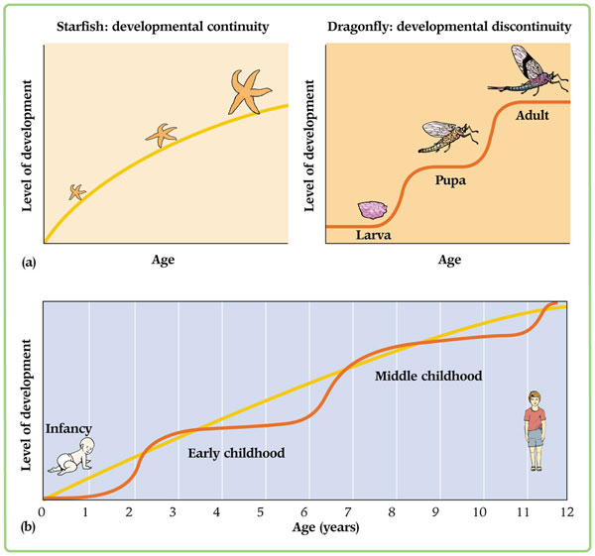
IS DEVELOPMENT CONTINUOUS?
Development means change – change can be abrupt or gradual
Two views of Human Development:
1. Stage Theories – Distinct phases to intellectual and personality development (Freud)
Age related changes include occasional large shifts so that children of different ages seem qualitatively different
2. Continuity – Development is ongoing and continuous (Rogers)
Age related changes occur gradually

Slide 7
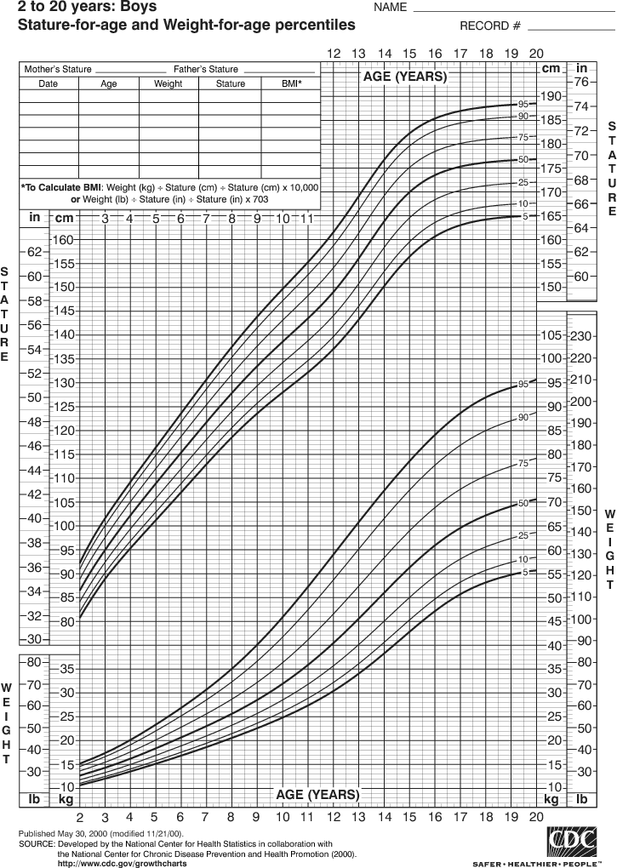
Physical Development
Physical development provides children with the abilities they need to explore and interact with the world around them. A young child's physical growth first begins as muscles gain strength and children gradually develop coordination.
Not limited to hitting percentiles on growth chart.
All children will grow in the same order, but at different rates.
Encompasses the term “Motor Development”
Parents can encourage healthy physical development by:
1. Children and young people should participate in at least 60 minutes (and up to several hours) of moderate- to vigorous-intensity physical activity every day.
2. Children and young people should not spend more than two hours a day using electronic media for entertainment (e.g. computer games, Internet, TV), particularly during daylight hours.

Slide 8
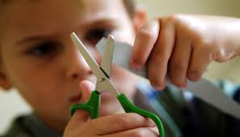
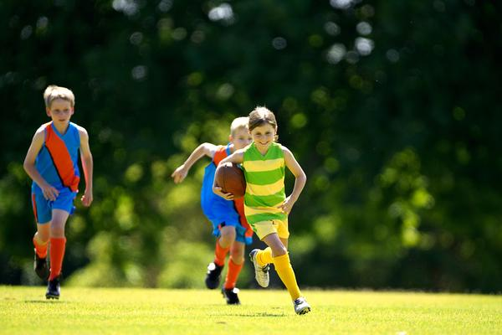
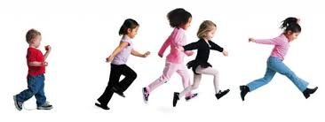
Motor Development
Children grow as a result of both maturation and learning
Maturation: internally programmed growth.
There is no point in pushing a child to develop if they have not reached maturational readiness. Eg. Walking requires coordination and nerve development.
Reflexes, Gross & Fine Motor Skills
Reflexes - Grasping & Rooting reflexes in newborns
Gross Motor Skills – coordination and control of large muscles & skills, (rolling over, walking, jumping).
Fine Motor Skills – coordination of small muscles & skills, (holding things, picking up small items, scribbling with a pencil).

Slide 9
Language Development
Language Development is a Multi-step Process:
1. Making the signs – by hand or by mouth
2. Giving them meaning
3. Using grammar (arranging symbols to produce new meanings).
Telegraphic Speech – missing words, but get meaning across, ie. “Daddy fall down”
Positive Errors “Daddy goed yesterday” – applying grammatical rules appropriately
Children imitate the sounds of those around them, receive praise when things sound like words & learn the language they are most exposed to. *Any infant could learn any other language just as easily.
Vocabulary Development
By 12 months – 5-10 words
By 18 months – vocab has doubled (between 18 months & 5 years, will add 5-10 words a day)
By 2 years -200-300 words
By 3 years – approaching 1000 words, beginning to include simple sentences
By 6 years – 2500 words, can understand more than 20,000 words
By adulthood – 50,000 words

Slide 10
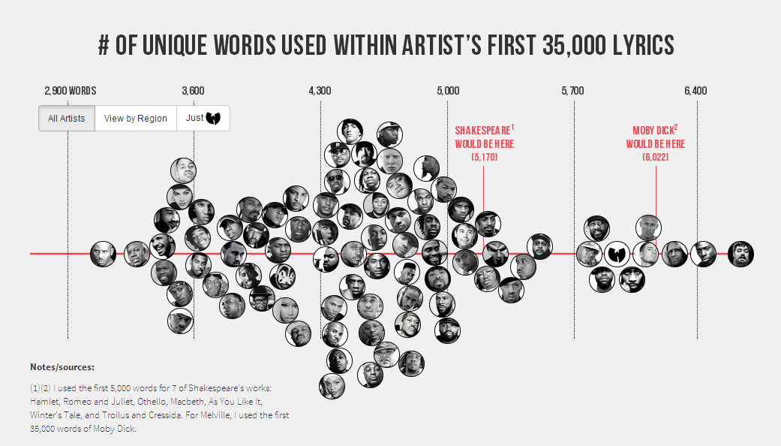
CLICK HERE

Slide 11
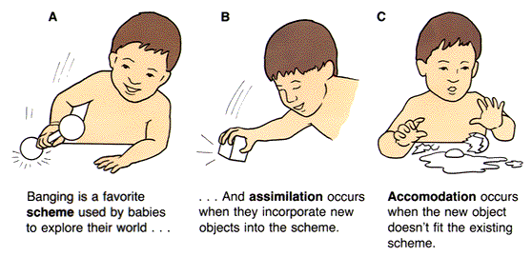
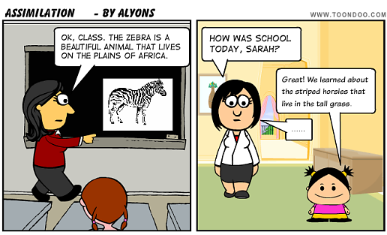
Cognitive Development
Intelligence, or the ability to understand, develops gradually as a child grows.
SCHEMES – understanding the world requires the construction of schemes – plans for knowing. As we learn, we have to construct schemes, apply them, and change them when necessary. When things don’t fit into existing schemes, we are required to develop new schemes.
Assimilation – A process whereby we try to fit the world into our existing scheme.
Accommodation – We change our scheme to fit the characteristics of the world.

Slide 12
Jean Piaget: Stages of Cognitive Development
DEVELOPMENTAL PHENOMENA
Object Permanence
Stranger Anxiety
Pretend Play
Egocentrism
Language Development
Conservation
Mathematical transformations
Abstract logic
Potential for mature moral reasoning
STAGE 1: Sensorimotor (Birth – 24 months)
Experiences the world through senses and actions (looking, touching, mouthing)
STAGE 2: Preoperational (2-6 years approx.)
Represents things with words and images but lacks logical reasoning.
STAGE 3: Concrete Operational (7-11 years approx.)
Thinks logically about concrete events; grasps concrete analogies and performs arithmetical operations.
STAGE 4: Formal Operational (12+ years)
Reasons abstractly, can consider alternative solutions to a problem, contemplate the future, and formulate personal ideals and values.

Slide 13
Emotional Development
Emotional Development is ongoing as a child develops physically and cognitively. Child begins to form attachments to specific people – mother in particular.
Experiments with animals have proven the importance of forming attachments early in life.
Imprinting – geese become attached to mothers suddenly & virtually permanently. Goslings follow first moving thing they see, so if it’s not their mother, they may imprint on something else ie. Human.
Surrogate mothers – monkeys removed from natural mothers at birth. Placed in enclosures with “wire mothers” and “cloth mothers.” Monkeys consistently sought out the “cloth” mother, (physical contact comfort.) Later in life, all monkeys removed from natural mothers exhibited severe emotional problems – possibly because:
No encouragement of independence
No opportunity to interact with peers and observe how other monkeys behaved.

Slide 14
Social Development
Socialization refers to the process by which we learn and follow the rules of behavior appropriate to the culture we live in.
Acceptable vs. unacceptable behaviors – learning to live with/around others.
Some social rules are clear and inflexible ie. incest
Others differ depending on situation, individual, gender, etc. ie. Boys encouraged to express aggression but not fear
BLOG POST – Week 6 – Using what you have learned about developmental psychology, How might physical, cognitive, language and emotional development play a role in the way that an individual develops socially? Is any one developmental area more critical than any other to “normal” social development? What are some ways in which development in other areas might impair social development? Ie.

